Slide 1
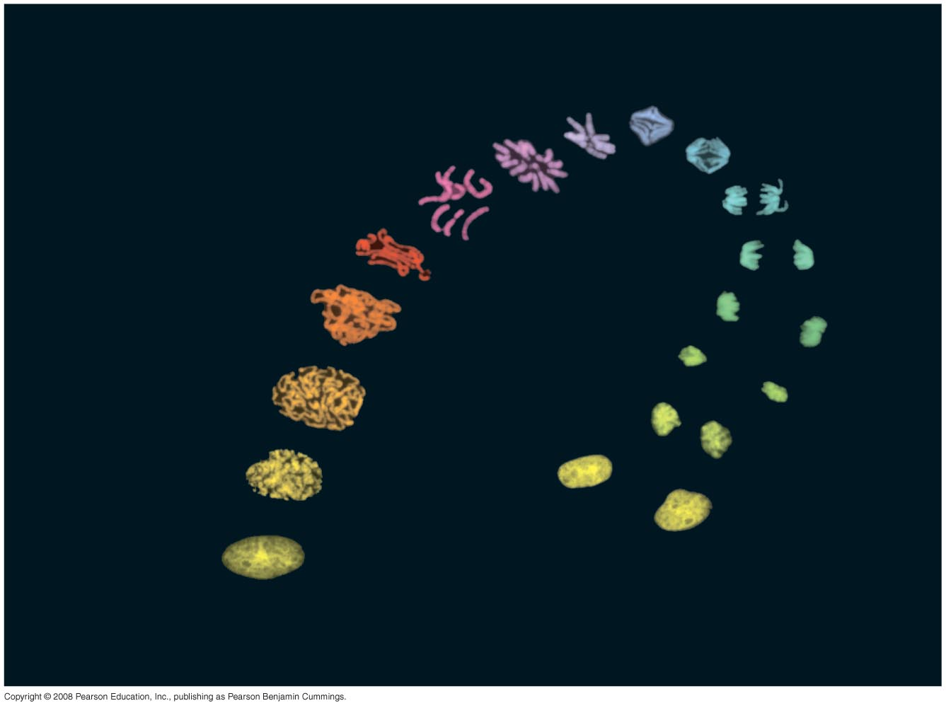
The Cell Cycle Control

Slide 2
The Evolution of Mitosis
Since prokaryotes evolved before eukaryotes, mitosis probably evolved from binary fission
Certain protists exhibit types of cell division that seem intermediate between binary fission and mitosis
Copyright © 2008 Pearson Education, Inc., publishing as Pearson Benjamin Cummings

Slide 3
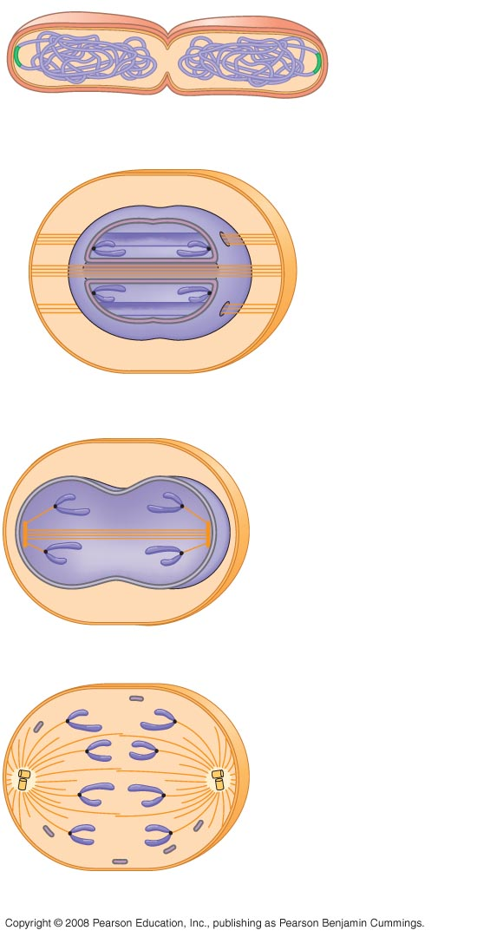
Bacterial
chromosome
(a) Bacteria
Chromosomes
Microtubules
Intact nuclear
envelope
(b) Dinoflagellates
Kinetochore
microtubule
Intact nuclear
envelope
(c) Diatoms and yeasts
Kinetochore
microtubule
Fragments of
nuclear envelope
(d) Most eukaryotes
Notes:
Figure 12.12 A hypothetical sequence for the evolution of mitosis

Slide 4
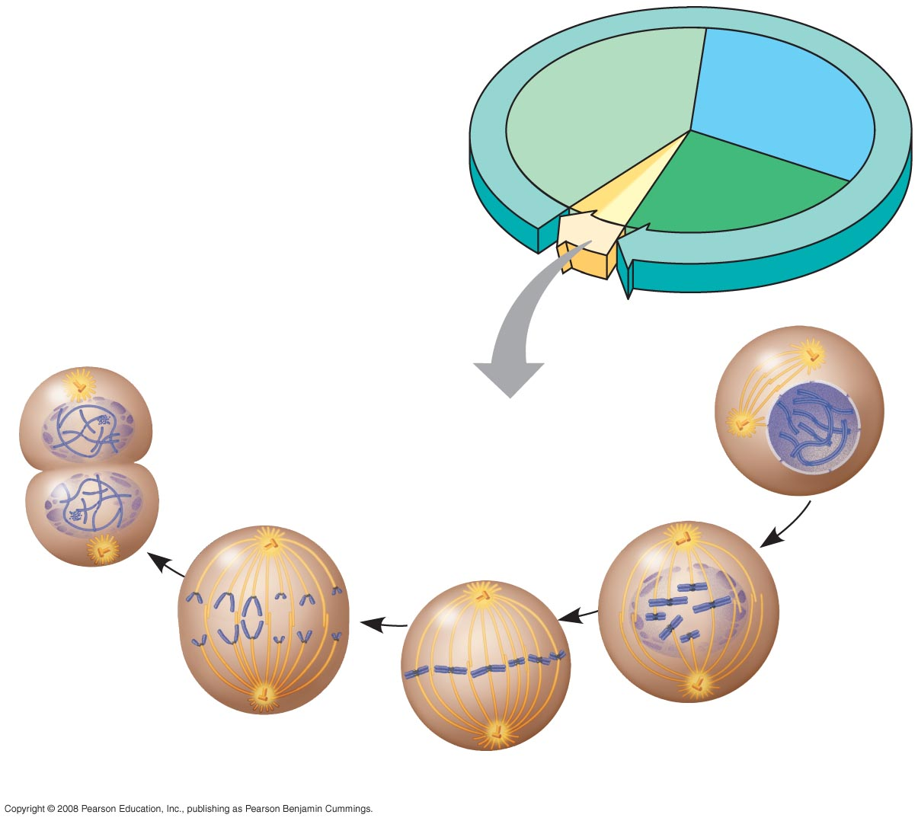
INTERPHASE
G₁
S
Cytokinesis
Mitosis
G₂
MITOTIC (M) PHASE
Prophase
Telophase and
Cytokinesis
Prometaphase
Anaphase
Metaphase

Slide 5
The eukaryotic cell cycle is regulated by a molecular control system
The frequency of cell division varies with the type of cell
These cell cycle differences result from regulation at the molecular level

Slide 6
Evidence for Cytoplasmic Signals
The cell cycle appears to be driven by specific chemical signals present in the cytoplasm
Some evidence for this hypothesis comes from experiments in which cultured mammalian cells at different phases of the cell cycle were fused to form a single cell with two nuclei

Slide 7
Masui and Markert’s study of oocyte maturation led to the identification of cyclin and cyclin-dependent kinase
Frog oocytes are dormant in G₂
Progesterone makes oocytes progress to M
Progesterone must be affecting triggers to progress to M
3 groups of donor oocytes
  Progesterone for 2 hours
  Progesterone for 12 hours
  No progesterone
Inject donor oocyte cytosol into recipient oocytes
Only 12 hour donor caused progression
Maturation Promoting Factor (MPF) is mitotic cyclin and cyclin-dependent kinase

Slide 8
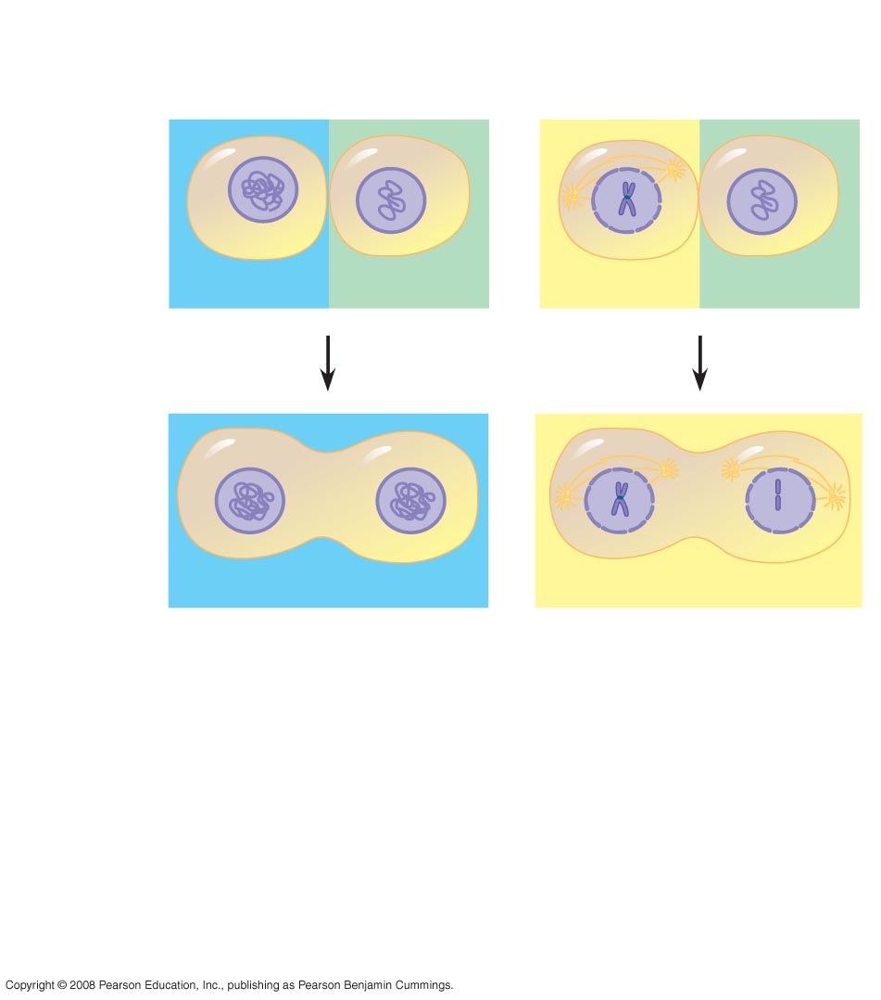
EXPERIMENT
Experiment 1
Experiment 2
S
G₁
M
G₁
RESULTS
S
S
M
M
When a cell in the
S phase was fused
with a cell in G₁, the G₁
nucleus immediately
entered the S
phase—DNA was
synthesized.
When a cell in the
M phase was fused with
a cell in G₁, the G₁
nucleus immediately
began mitosis—a
spindle formed and
chromatin condensed,
even though the
chromosome had not
been duplicated.
Notes:
Figure 12.13 Do molecular signals in the cytoplasm regulate the cell cycle?

Slide 9
The Cell Cycle Control System
The sequential events of the cell cycle are directed by a distinct cell cycle control system, which is similar to a clock
The cell cycle control system is regulated by both internal and external controls
The clock has specific checkpoints where the cell cycle stops until a go-ahead signal is received

Slide 10
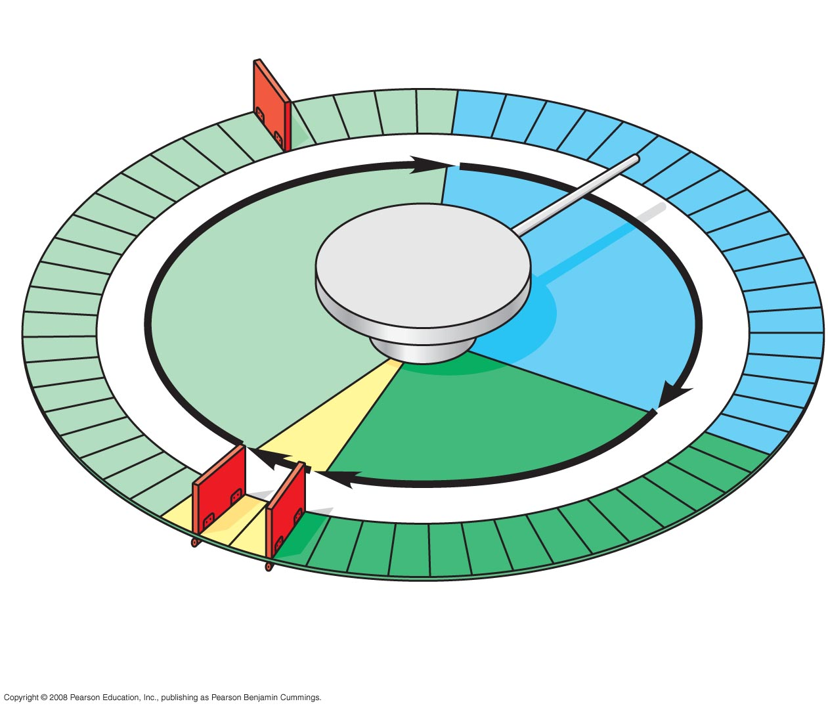
G₁ checkpoint
Control
system
S
G₁
M
G₂
M checkpoint
G₂ checkpoint
Notes:
Figure 12.14 Mechanical analogy for the cell cycle control system

Slide 11
For many cells, the G₁ checkpoint seems to be the most important one
If a cell receives a go-ahead signal at the G₁ checkpoint, it will usually complete the S, G₂, and M phases and divide
If the cell does not receive the go-ahead signal, it will exit the cycle, switching into a nondividing state called the G₀ phase

Slide 12
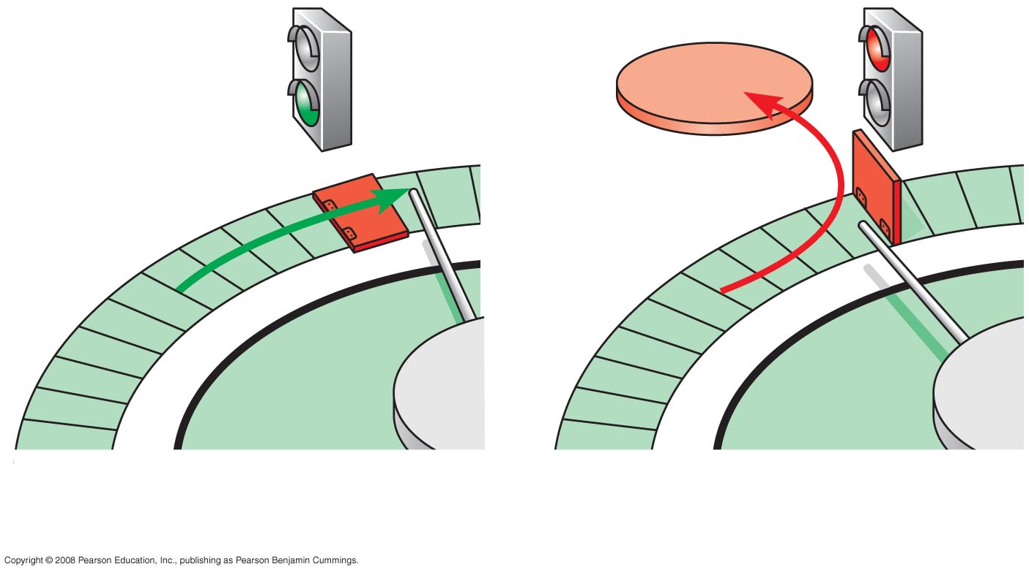
G₀
G₁ checkpoint
G₁
G₁
Cell receives a go-ahead
signal
(b) Cell does not receive a
go-ahead signal
Notes:
Figure 12.15 The G₁ checkpoint

Slide 13
The Cell Cycle Clock:
Cyclins and Cyclin-Dependent Kinases
Two types of regulatory proteins are involved in cell cycle control: cyclins and cyclin-dependent kinases (Cdks)
The activity of cyclins and Cdks fluctuates during the cell cycle
MPF (maturation-promoting factor) is a cyclin-Cdk complex that triggers a cell’s passage past the G₂ checkpoint into the M phase

Slide 14
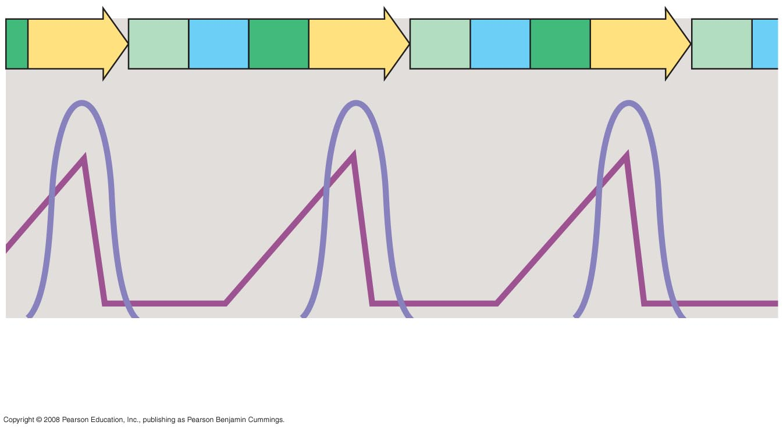
M
G₁
S
G₂
M
G₁
S
G₂
M
G₁
MPF activity
Cyclin
concentration
Time
(a) Fluctuation of MPF activity and cyclin concentration during
the cell cycle
Notes:
Figure 12.17 Molecular control of the cell cycle at the G₂ checkpoint

Slide 15
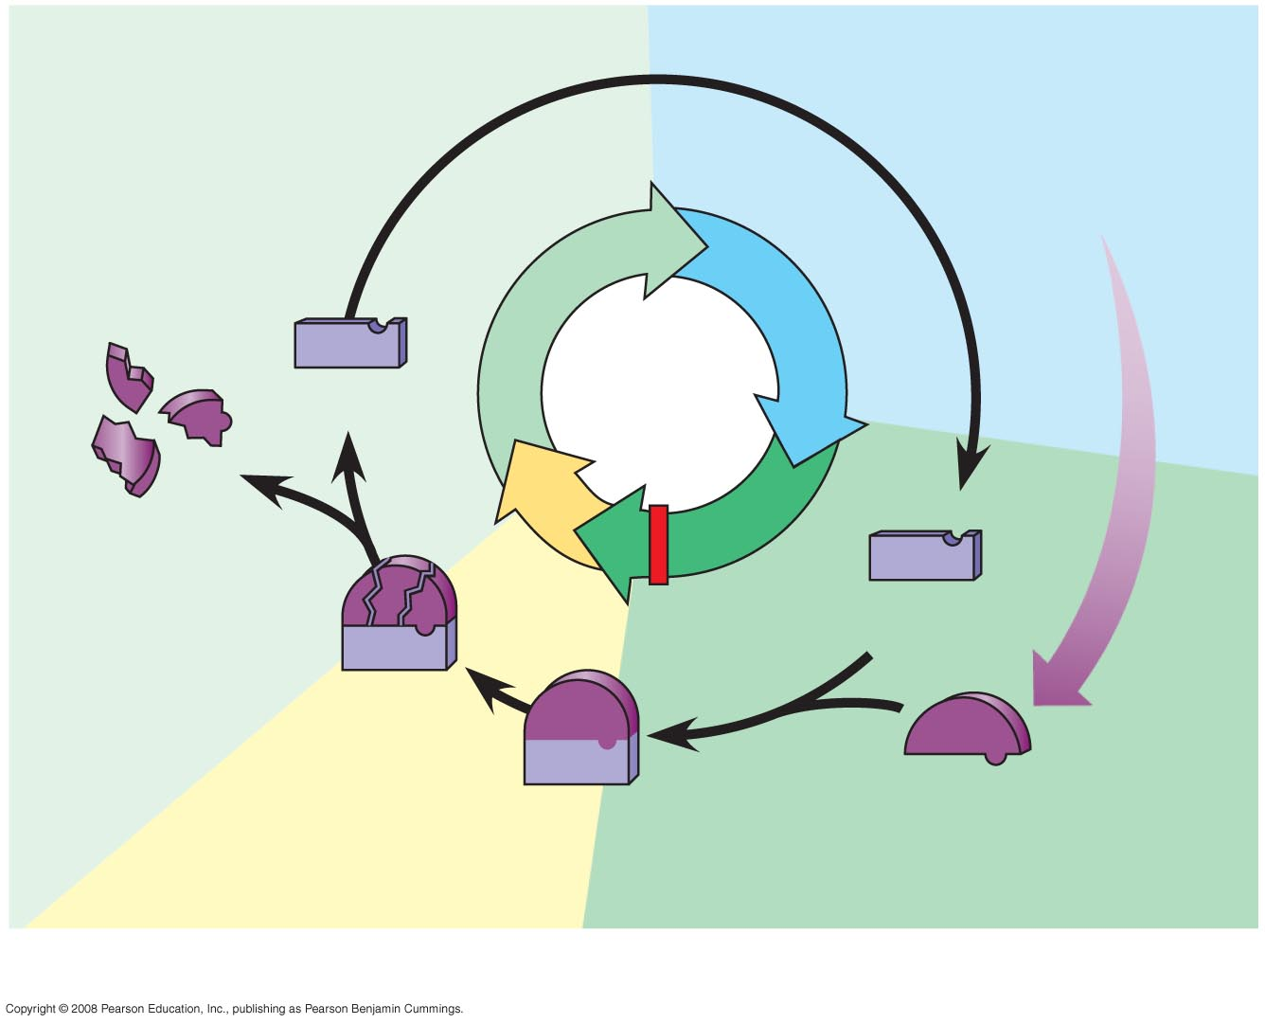
G₁
S
Cdk
M
Cyclin accumulation
Degraded
cyclin
G₂
G₂
checkpoint
Cdk
Cyclin is
degraded
Cyclin
MPF
(b) Molecular mechanisms that help regulate the cell cycle
Notes:
Figure 12.17 Molecular control of the cell cycle at the G₂ checkpoint

Slide 16
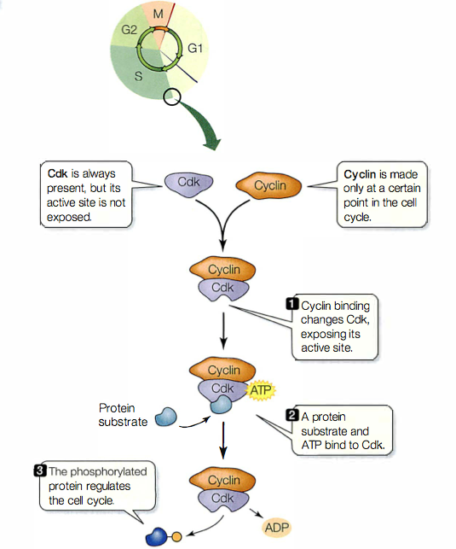

Slide 17
• Cyclin D-Cdk4 acts during the middle of G1 . It moves the cell past the restriction point (R), a key decision point beyond which the rest of the cell cycle is normally inevitable.
• Cyclin E-Cdk2 also acts in the middle of G1; it works in concert with Cyclin D-Cdk4 to move the cell cycle past the restriction point.
• Cyclin A-Cdk2 acts during the S phase to stimulate DNA replication.
• Cyclin B-Cdk1 acts at the G2-M boundary, initiating the transition to mitosis.

Slide 18
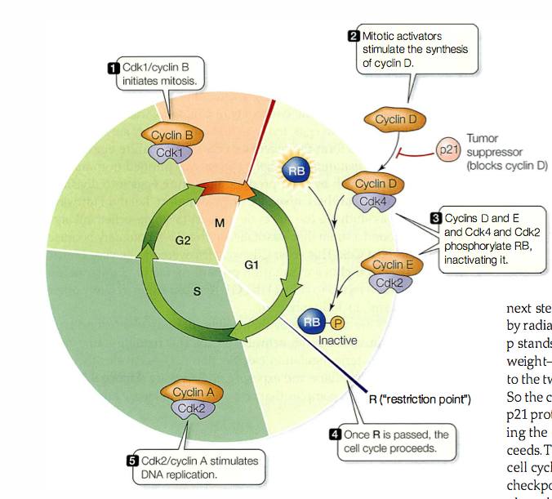
Rb protein: the first major checkpoint

Slide 19
pRB regulation depends on phosphorylation
pRb binds to E2F transcription factors to block their function
pRb can actively inhibit cell cycle progression when it is dephosphorylated
Therefore phosphorylation inactivates its function.
At the end of mitosis (M phase) pRB depends on a phosphatase to dephosphyorylate it, allowing it to bind to E2F again

Slide 20
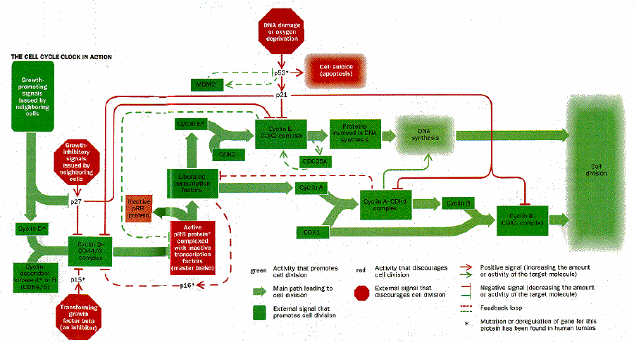
p53, p21 & The Second Major Checkpoint
Robert A. Weinberg, How Cancer Arises, Scientific American 275(3):62-70, September 1996.

Slide 21
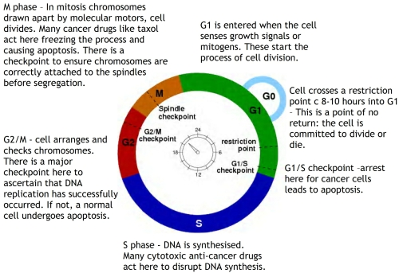
p53
Rb
Cell Cycle Checkpoints

Slide 22
Stop and Go Signs: Internal and External Signals at the Checkpoints
An example of an internal signal is that kinetochores not attached to spindle microtubules send a molecular signal that delays anaphase
Some external signals are growth factors, proteins released by certain cells that stimulate other cells to divide
For example, platelet-derived growth factor (PDGF) stimulates the division of human fibroblast cells in culture

Slide 23
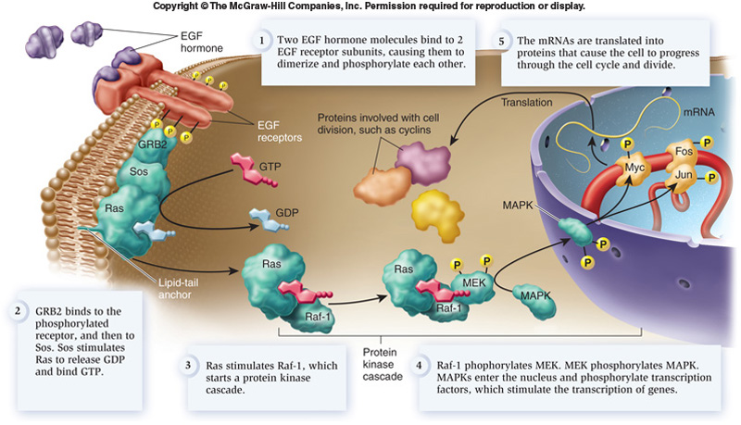
External Signals-Growth Factors

Slide 24
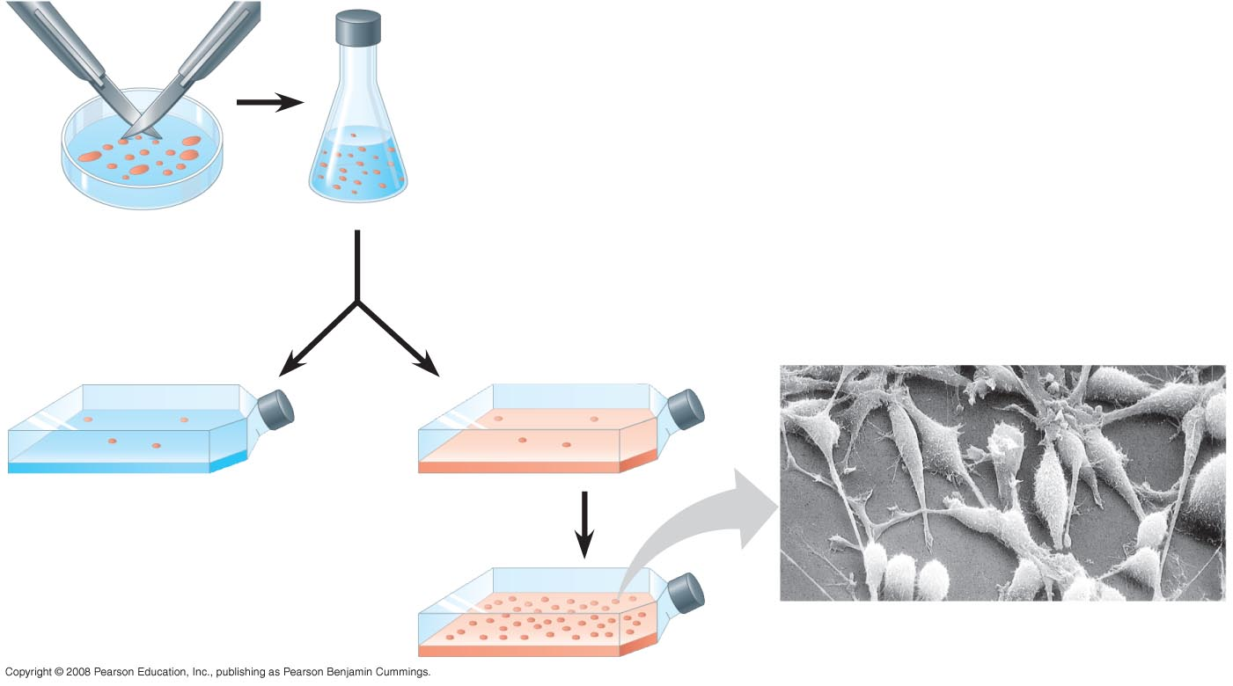
External Signals-Growth Factors
Scalpels
Petri
plate
Without PDGF
cells fail to divide
With PDGF
cells prolifer-
ate
Cultured fibroblasts
10 µm
Notes:
Figure 12.18 The effect of a growth factor on cell division

Slide 25
Another example of external signals is density-dependent inhibition, in which crowded cells stop dividing
Most animal cells also exhibit anchorage dependence, in which they must be attached to a substratum in order to divide

Slide 26
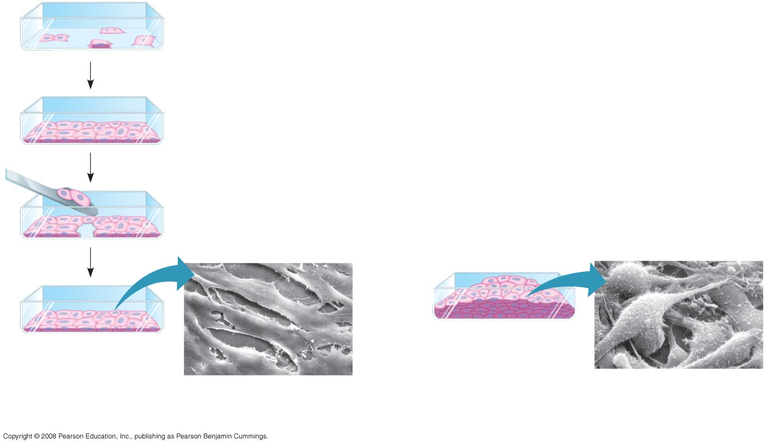
External Signals-Physical fctors
Anchorage dependence
Density-dependent inhibition
Density-dependent inhibition
25 µm
25 µm
(a) Normal mammalian cells
(b) Cancer cells
Notes:
Figure 12.19 Density-dependent inhibition and anchorage dependence of cell division

